Slide 1
IPv4 and IPv6
Header format
20.<number>

Slide 2
IPv4
The Internet Protocol version 4 (IPv4) is the delivery mechanism used by the TCP/IP protocols.
20.<number>

Slide 3

Position of IPv4 in TCP/IP protocol suite

Slide 4

IPv4 datagram format
20.<number>

Slide 5

Header Length :
multiple sized headers so we need this field.
Header will always be a multiple of 4 bytes and so we can have a maximum length of the field as 15, so the maximum size of the header is 60 bytes ( 20 bytes are mandatory ).
Type Of Service (ToS) : This helps the router in taking the right routing decisions. The structure is :
First three bits : They specify the precedences i.e. the priority of the packets.
Next three bits :
  D bit - D stands for delay. If the D bit is set to 1, then this means that the application is delay sensitive, so we should try to route the packet with minimum delay.
  T bit - T stands for throughput. This tells us that this particular operation is throughput sensitive.
  R bit - R stands for reliability. This tells us that we should route this packet through a more reliable network.
Last two bits: The last two bits are never used.
20.<number>

Slide 6
ID Field : The source and ID field together will represent the fragments of a unique packet. So each fragment will have a different ID.
Offset : It is a 13 bit field that represents where in the packet, the current fragment starts. Each bit represents 8 bytes of the packet. So the packet size can be at most 64 kB. Every fragment except the last one must have its size in bytes as a multiple of 8 in order to ensure compliance with this structure.
Flags :It has three bits -
  M bit : If M is one, then there are more fragments on the way and if M is 0, then it is the last fragment
  DF bit : If this bit is sent to 1, then we should not fragment such a packet.
  Reserved bit : This bit is not used.
20.<number>

Slide 7
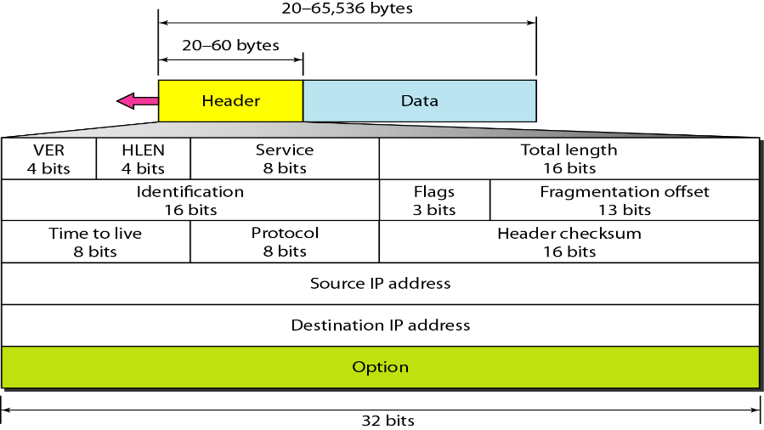
Total Length : It includes the IP header and everything that comes after it.
Time To Live (TTL) : Using this field, we can set the time within which the packet should be delivered or else destroyed. It is strictly treated as the number of hops.
Protocol : This specifies the module to which we should hand over the packet ( UDP or TCP ). It is the next encapsulated protocol.
Header Checksum : This is the usual checksum field used to detect errors. Since the TTL field is changing at every router so the header checksum ( upto the options field ) is checked and recalculated at every router.
Source : It is the IP address of the source node
Destination : It is the IP address of the destination node.
IP Options : The options field was created in order to allow features to be added into IP as time passes and requirements change.
20.<number>

Slide 8

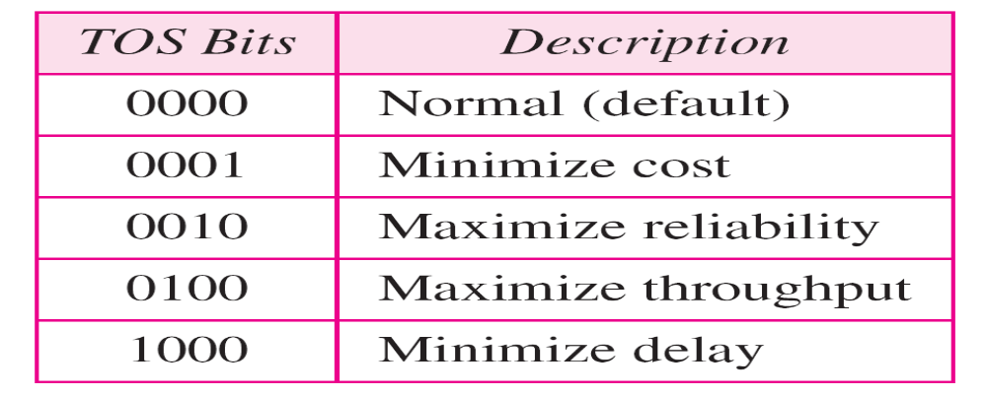
Service type or differentiated services
20.<number>

Slide 9
The total length field defines the total length of the datagram including the header.
20.<number>

Slide 10

Encapsulation of a small datagram in an Ethernet frame
20.<number>

Slide 11

Protocol field and encapsulated data
20.<number>

Slide 12

Protocol values
20.<number>

Slide 13
An IPv4 packet has arrived with the first 8 bits as shown:
01000010
The receiver discards the packet. Why?
Solution
There is an error in this packet. The 4 leftmost bits (0100) show the version, which is correct. The next 4 bits (0010) show an invalid header length (2 × 4 = 8). The minimum number of bytes in the header must be 20. The packet has been corrupted in transmission.
20.<number>

Slide 14
In an IPv4 packet, the value of HLEN is 1000 in binary. How many bytes of options are being carried by this packet?
Solution
The HLEN value is 8, which means the total number of bytes in the header is 8 × 4, or 32 bytes. The first 20 bytes are the base header, the next 12 bytes are the options.
20.<number>

Slide 15
In an IPv4 packet, the value of HLEN is 5, and the value of the total length field is 0x0028. How many bytes of data are being carried by this packet?
Solution
The HLEN value is 5, which means the total number of bytes in the header is 5 × 4, or 20 bytes (no options). The total length is 40 bytes, which means the packet is carrying 20 bytes of data (40 − 20).
20.<number>

Slide 16

Maximum transfer unit (MTU)
20.<number>

Slide 17

MTUs for some networks
20.<number>

Slide 18

Flags used in fragmentation
20.<number>

Slide 19

Fragmentation example
Identifies sequence of frames using the fragment offset(13 bits) field in IP header
20.<number>

Slide 20

Detailed fragmentation example
20.<number>

Slide 21

Example of checksum calculation in IPv4
20.<number>

Slide 22
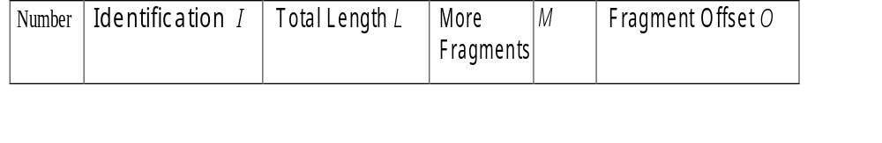
Consider sending a 3,000 byte datagram into a link which has an MTU of 500 bytes. Suppose the original datagram is stamped with the identification number 422. How many fragments are generated? What are their characteristics?
20.<number>

Slide 23
Assume that the DF flag was not set : )
Assume that no optional fields of the IP header are in use (i.e. IP header is 20 bytes)
The original datagram was 3000 bytes, subtracting 20 bytes for header, that leaves 2980 bytes of data.
Assume the ID of the original packet is 'x'
With an MTU of 500 bytes, 500 - 20 = 480 bytes of data may be transmitted in each packet
Therefore, ceiling(2980 / 480) = 7 packets are needed to carry the data.
The packets will have the following characteristics (NOTE: offset is measured in 8 byte blocks, you don't need to specify Total_len)
Packet 1: ID=x, Total_len=500, MF=1, Frag_offset=0
Packet 2: ID=x, Total_len=500, MF=1, Frag_offset=60
Packet 3: ID=x, Total_len=500, MF=1, Frag_offset=120
Packet 4: ID=x, Total_len=500, MF=1, Frag_offset=180
Packet 5: ID=x, Total_len=500, MF=1, Frag_offset=240
Packet 6: ID=x, Total_len=500, MF=1, Frag_offset=300
Packet 7: ID=x, Total_len=120, MF=0, Frag_offset=360

Slide 24
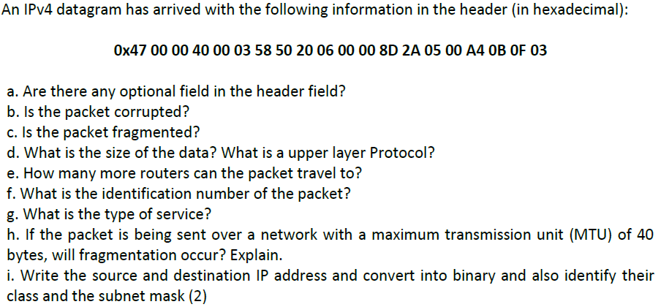
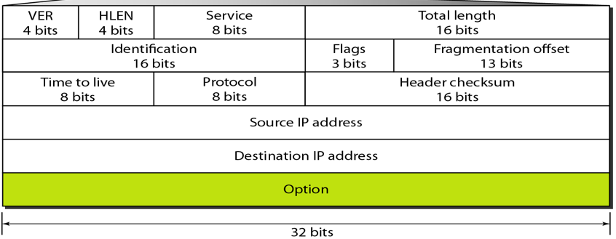
20.<number>

Slide 25
Field Bits Description
Version 4 Indicates IP version. For IPv4, value = 4
IHL (Internet Header Length) 4 Specifies header length in 32-bit words. Minimum = 5
DSCP 6 Used for differentiated services/QoS
ECN 2 Explicit Congestion Notification
Total Length 16 Total size of IP packet, including header and data
Identification 16 Identifies fragments belonging to the same original packet
Flags 3 Controls fragmentation
Fragment Offset 13 Indicates the position of a fragment in the original packet
TTL (Time to Live) 8 Limits the packet's lifetime/hop count
Protocol 8 Identifies the upper-layer protocol, e.g., TCP = 6, UDP = 17
Header Checksum 16 Detects errors in the IPv4 header
Source Address 32 IPv4 address of the sender
Destination Address 32 IPv4 address of the receiver
Options + Padding 0–320 Optional fields; makes header larger than 20 bytes
20.<number>

Slide 26
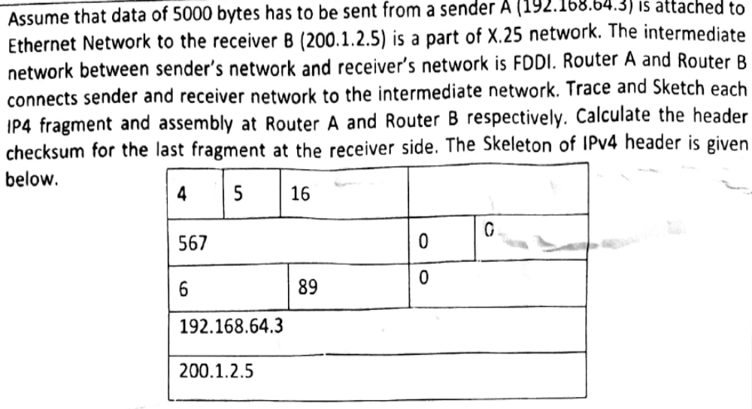
20.<number>

Slide 27

20.<number>

Slide 28
Efficiency (e) = useful/total = (Data without header)/(Data with header)
Throughput = e * B { where B is bottleneck bandwidth }
An IP router with a Maximum Transmission Unit (MTU) of 200 bytes has received an IP packet of size 520 bytes with an IP header of length 20 bytes. The values of the relevant fields in the IP header.
20.<number>

Slide 29
MTU is 200 bytes and 20 bytes is header size so,
maximum length of data = 180 bytes
but it can be represented in fragment offset since not divisible by 8 so,
maximum length of data feasible = 176 bytes.
Number of fragments = (520/200) = 3.
Header length = 5 (since scaling factor is 4 therefore, 20/4 = 5)
Efficiency, e = (Data without header)/(Data with header) = 500/560 = 89.2 %
20.<number>

Slide 30
20.<number>

Slide 31
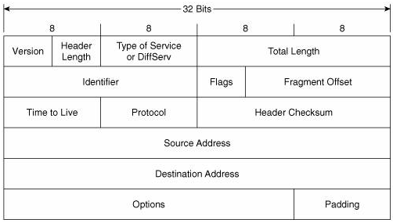
20.<number>

Slide 32
0X4500 005C 0003 0000 5906
1000101000000000000000001011100
000000000000001100000000000000000101100100000110
Each digit is of 4bit as given in hexa notation. 32 bits or 8hexa digit represent one row in packet format.
Time To Live (TTL):-It is of 8 bit field. This field indicates the maximum time the datagram is allowed to remain in the internet system. If this field contains the value zero, then the datagram must be destroyed. This field is modified in internet header processing. The time is measured in units of seconds, but since every module that processes a datagram must decrease the TTL by at least one even if it process the datagram in less than a second, the TTL must be thought of only as an upper bound on the time a datagram may exist. The intention is to cause undeliverable datagrams to be discarded, and to bound the maximum datagram lifetime. <hops> must be a number in the range [0–255].
See in packet format TTL in third row starting and contains 8bits.
59 in hexa = 89 hops
Each hexadecimal digit i.e. Base 16 is equivalent to 4 binary digits i.e Base 2
In Ipv4 header format TTL is just after 64 bits (2 rows) which is equal to 64/4 = 16 hex digit. So skip 16 hex digit get next 8 bits as TTL is of 8 bit.
That means next two hex digit are TTL bits which is 59 = 01011001 = 89
20.<number>

Slide 33
In an IPv4 datagram, the M bit is 0, the value of HLEN is 10, the value of total length is 400 and the fragment offset value is 300. The position of the datagram, the sequence numbers of the first and the last bytes of the payload, respectively are
(A) Last fragment, 2400 and 2789
(B) First fragment, 2400 and 2759
(C) Last fragment, 2400 and 2759
(D) Middle fragment, 300 and 689
20.<number>

Slide 34
Explanation:
M = 0 indicates that this packet is the last packet among all fragments of original packet. So the answer is either A or C.
It is given that HLEN field is 10. Header length is number of 32 bit words.
So header length = 10 * 4 = 40
Also, given that total length = 400.
Total length indicates total length of the packet including header.
So, packet length excluding header = 400 – 40 = 360
Last byte address = 2400 + 360 – 1 = 2759 (Because numbering starts from 0)
20.<number>

Slide 35
An IP router with a Maximum Transmission Unit (MTU) of 1500 bytes has received an IP packet of size 4404 bytes with an IP header of length 20 bytes. The values of the relevant fields in the header of the third IP fragment generated by the router for this packet are
(A) MF bit: 0, Datagram Length: 1444; Offset: 370
(B) MF bit: 1, Datagram Length: 1424; Offset: 185
(C) MF bit: 1, Datagram Length: 1500; Offset: 37
(D) MF bit: 0, Datagram Length: 1424; Offset: 2960
20.<number>

Slide 36
Number of packet fragments = ⌈ (total size of packet)/(MTU) ⌉
= ⌈ 4404/1500 ⌉
= ⌈ 2.936 ⌉
= 3
So Datagram with data 4404 byte fragmented into 3 fragments.
The first frame carries bytes 0 to 1479 (because MTU is 1500 bytes and HLEN is 20 byte so the total bytes in fragments is maximum 1500-20=1480). the offset for this datagram is 0/8 = 0.
20.<number>

Slide 37
Host A sends a UDP datagram containing 8880 bytes of user data to host B over an Ethernet LAN. Ethernet frames may carry data up to 1500 bytes (i.e. MTU = 1500 bytes). Size of UDP header is 8 bytes and size of IP header is 20 bytes. There is no option field in IP header. How may total number of IP fragments will be transmitted and what will be the contents of offset field in the last fragment?
(A) 6 and 925
(B) 6 and 7400
(C) 7 and 1110
(D) 7 and 8880
20.<number>

Slide 38
UDP data = 8880 bytes
UDP header = 8 bytes
IP Header = 20 bytes
Total Size excluding IP Header = 8888 bytes.
Number of fragments = ⌈ 8888 / 1480 ⌉
= 7
Refer the Kurose book slides on IP (Offset is always scaled by 8)
Offset of last segment = (1480 * 6) / 8 = 1110
20.<number>

Slide 39
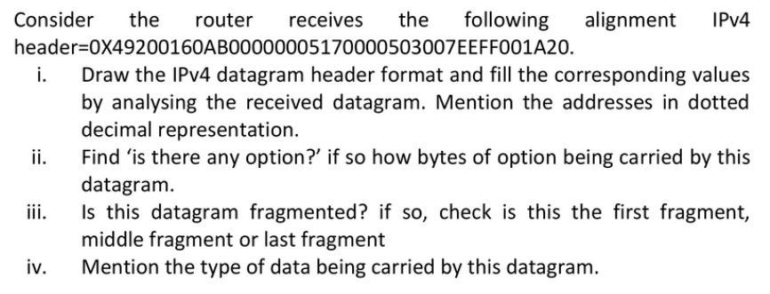
20.<number>

Slide 40
20.<number>

Slide 41
IPv6
The network layer protocol in the TCP/IP protocol suite is currently IPv4. Although IPv4 is well designed, data communication has evolved since the inception of IPv4 in the 1970s. IPv4 has some deficiencies that make it unsuitable for the fast-growing Internet.
20.<number>

Slide 42

IPv6 datagram header and payload
20.<number>

Slide 43

Format of an IPv6 datagram
20.<number>

Slide 44

Next header codes for IPv6
20.<number>

Slide 45

Priorities for congestion-controlled traffic
20.<number>

Slide 46

Priorities for noncongestion-controlled traffic
20.<number>

Slide 47
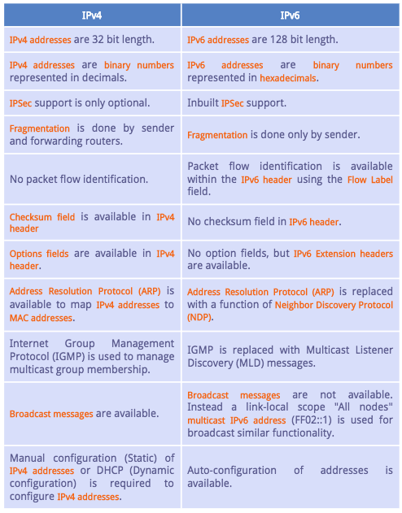
20.<number>

Slide 48

Comparison between IPv4 and IPv6 packet headers
20.<number>

Slide 49

Extension header types
20.<number>

Slide 50
Comparison between IPv4 options and IPv6 extension headers
20.<number>

Slide 51
TRANSITION FROM IPv4 TO IPv6
Because of the huge number of systems on the Internet, the transition from IPv4 to IPv6 cannot happen suddenly. It takes a considerable amount of time before every system in the Internet can move from IPv4 to IPv6. The transition must be smooth to prevent any problems between IPv4 and IPv6 systems.
Topics discussed in this section:
Dual Stack
Tunneling
Header Translation
20.<number>

Slide 52

Three transition strategies
20.<number>

Slide 53

Dual stack
20.<number>

Slide 54

Tunneling strategy
20.<number>

Slide 55

Header translation strategy
20.<number>

Slide 56
Header translation
20.<number>

